Slide 1
Two-Dimensional Kinematics in Polar Coordinate Systems
Dr. Jacob Moore
Associate Professor of Engineering
Penn State Mont Alto

Slide 2
Curvilinear Motion
Curvilinear motion is motion that follows a curved path.
Planar motion (2-D Motion) is curvilinear motion that follows a curve in a single plane
So far, we have dealt with only a single dimension, but to describe curvilinear motion we will need at least 2 dimensions.
Options for these two dimensions include:
Rectangular (horizontal position and vertical position from a stationary origin)
Normal and Tangential Coordinates (rectangular coordinates that are attached to the object in motion)
Polar Coordinates (angle and magnitude of vector from a stationary origin)

Slide 3





Planar Motion with Polar Coordinates (Position)
$$\vec{r}= r \hat{u_{r}}$$
y
$$r$$
$${\hat{u}}_{θ}$$
$$θ$$
$${\hat{u}}_{r}$$
x

Slide 4





Planar Motion with Polar Coordinates (Velocity)
$$\vec{r}= r \hat{u_{r}}$$
$$\vec{v}= \dot{r} \hat{u_{r}}+r \dot{\hat{u_{r}}}$$
$$\vec{v}= \dot{r} \hat{u_{r}}+r \dot{θ} \hat{u_{θ}}$$
Product Rule
Derivative of a Rotating Unit Vector
y
$$r$$
$${\hat{u}}_{θ}$$
$$θ$$
$${\hat{u}}_{r}$$
x

Slide 5
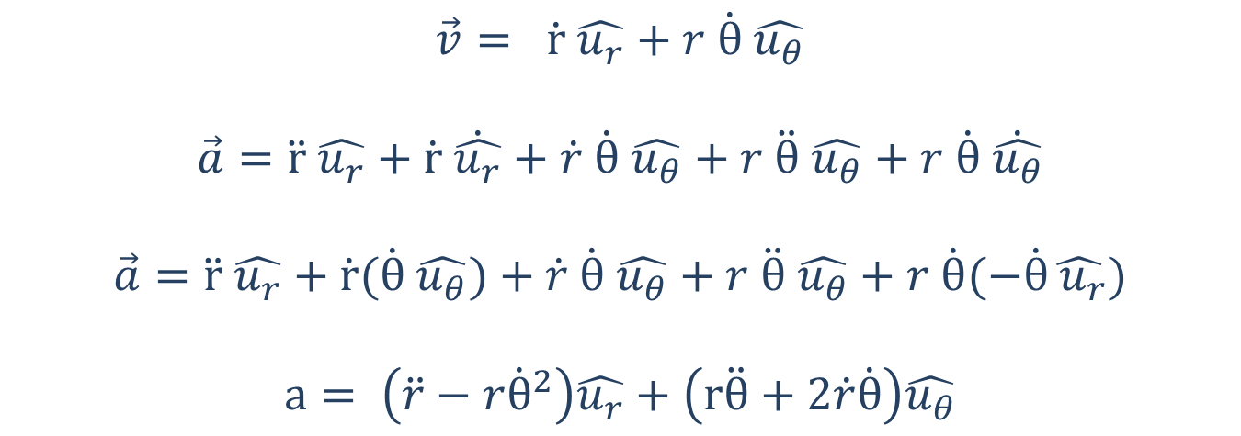




Planar Motion with Polar Coordinates (Acceleration)
$$\vec{v}= \dot{r} \hat{u_{r}}+r \dot{θ} \hat{u_{θ}}$$
$$\vec{a}=\ddot{r} \hat{u_{r}}+\dot{r} \dot{\hat{u_{r}}}+\dot{r} \dot{θ} \hat{u_{θ}}+r \ddot{θ} \hat{u_{θ}}+r \dot{θ} \dot{\hat{u_{θ}}}$$
$$\vec{a}=\ddot{r} \hat{u_{r}}+\dot{r}(\dot{θ} \hat{u_{θ}})+\dot{r} \dot{θ} \hat{u_{θ}}+r \ddot{θ} \hat{u_{θ}}+r \dot{θ}(−\dot{θ}\hat{ u_{r}})$$
$$a= \left(\ddot{r}−r{\dot{θ}}^{2}\right)\hat{u_{r}}+\left(r\ddot{θ}+2\dot{r}\dot{θ}\right)\hat{u_{θ}}$$
Product Rule
Derivative of a Rotating Unit Vector
y
$$r$$
$${\hat{u}}_{θ}$$
$$θ$$
$${\hat{u}}_{r}$$
x

Slide 6







Derivative of a Rotating Unit Vector
$${d\hat{u}}_{θ}$$
$${\hat{u}}_{θ}$$
$${\hat{u}}_{θ}$$
$${\hat{u}}_{r}$$
$$dθ$$
$${d\hat{u}}_{r}$$
$${\hat{u}}_{r}$$

Slide 7
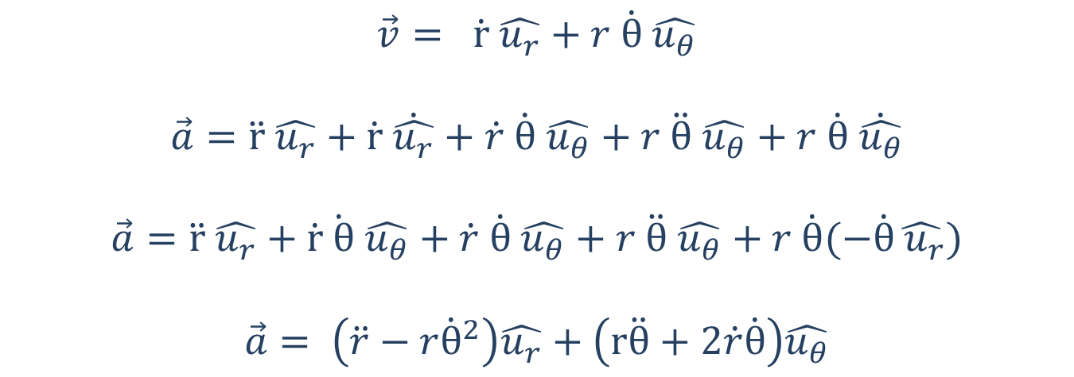
Planar Motion with Polar Coordinates (Acceleration)
$$\vec{v}= \dot{r} \hat{u_{r}}+r \dot{θ} \hat{u_{θ}}$$
$$\vec{a}=\ddot{r} \hat{u_{r}}+\dot{r} \dot{\hat{u_{r}}}+\dot{r} \dot{θ} \hat{u_{θ}}+r \ddot{θ} \hat{u_{θ}}+r \dot{θ} \dot{\hat{u_{θ}}}$$
$$\vec{a}=\ddot{r} \hat{u_{r}}+\dot{r}\dot{ θ} \hat{u_{θ}}+\dot{r} \dot{θ} \hat{u_{θ}}+r \ddot{θ} \hat{u_{θ}}+r \dot{θ}(−\dot{θ}\hat{ u_{r}})$$
$$\vec{a}= \left(\ddot{r}−r{\dot{θ}}^{2}\right)\hat{u_{r}}+\left(r\ddot{θ}+2\dot{r}\dot{θ}\right)\hat{u_{θ}}$$
Product Rule
Derivative of a Rotating Unit Vector
Simplify
y
$$r$$
$${\hat{u}}_{θ}$$
$$θ$$
$${\hat{u}}_{r}$$
x

Slide 8

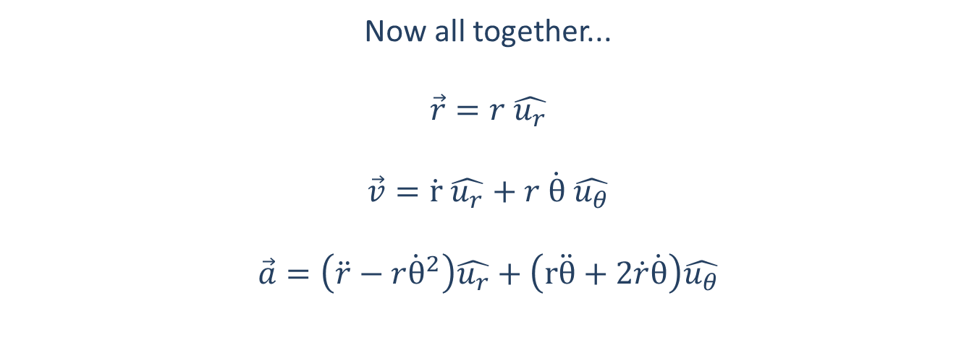



Planar Motion
Now all together...
$$\vec{r}=r \hat{u_{r}}$$
$$\vec{v}=\dot{r} \hat{u_{r}}+r \dot{θ} \hat{u_{θ}}$$
$$\vec{a}=\left(\ddot{r}−r{\dot{θ}}^{2}\right)\hat{u_{r}}+\left(r\ddot{θ}+2\dot{r}\dot{θ}\right)\hat{u_{θ}}$$
y
$$r$$
$$u_{θ}$$
$$u_{r}$$
$$θ$$
x

Slide 9

Planar Motion
Or in separate r and theta equations
Positions
$r_{r}=r$ $r_{θ}=0$
Velocities
$v_{r}=\dot{r}$ $v_{θ}=r \dot{θ}$
Accelerations
$$a_{r}=\ddot{r}−r{\dot{θ}}^{2} a_{θ}=r\ddot{θ}+2\dot{r}\dot{θ}$$

Slide 10







Using Coordinate Systems
It’s important to remember that even though these are not the coordinate directions we are used to, they are still just directions and what we are solving for are the components in each direction.
We can take any acceleration vector and break it down into “r” and “theta” components just like we break things down into x and y components.
We can also find the overall magnitude using the Pythagorean Theorem and find directions with the inverse tangent function, just as we did with rectangular coordinates
$$v_{r}$$
$$v_{θ}$$
y
$$\vec{v}$$
$$r$$
$$θ$$
x

Slide 11
Thanks for Watching
See other engineering mechanics videos and access the full tool at…

Slide 12
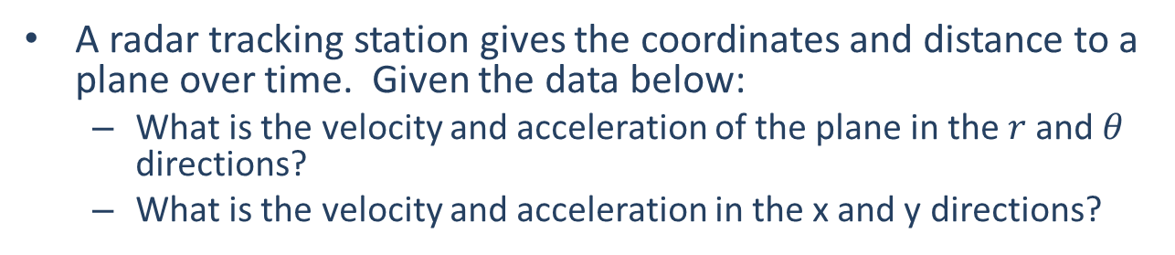


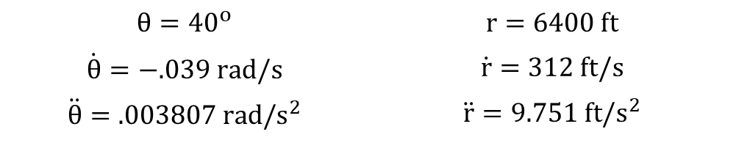
Worked Example
A radar tracking station gives the coordinates and distance to a plane over time. Given the data below:
What is the velocity and acceleration of the plane in the $r$and $θ$ directions?
What is the velocity and acceleration in the x and y directions?
$$θ={40}^{o}$$ | $$r=6400 ft$$
$$\dot{θ}=−.039 rad/s$$ | $$\dot{r}=312 ft/s$$
$$\ddot{θ}=.003807 rad/s^{2}$$ | $$\ddot{r}=9.751 ft/s^{2}$$
y
$$r$$
$$θ$$
x

Slide 13





Worked Example
A spotlight is tracking an actor as he moves across the stage. If the actor is moving with a constant velocity as shown below, what values do we need for the spotlight angular velocity (theta dot) and spotlight angular acceleration (theta double dot) so that the spotlight remains fixed on the actor?
$$v=.75 m/s$$
55º
$$r=20 m$$
$$\dot{θ}= ?$$
$$\ddot{θ}= ?$$

